Slide 1
ReactJS Demo

Slide 2
First React App
Install npm create-react-app -g
Create a react application using
create-react-app <app-name>
Navigate inside the app-name project.
Run your application using
npm start

Slide 3
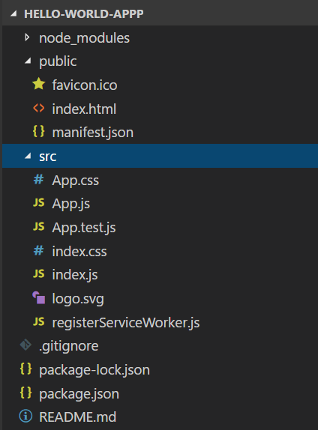
Understanding the Folder Structure

Slide 4
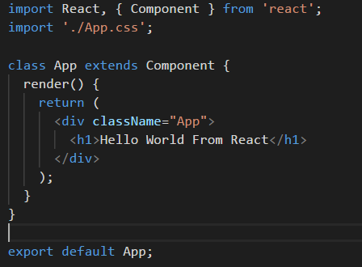
React Components - Basics

Slide 5
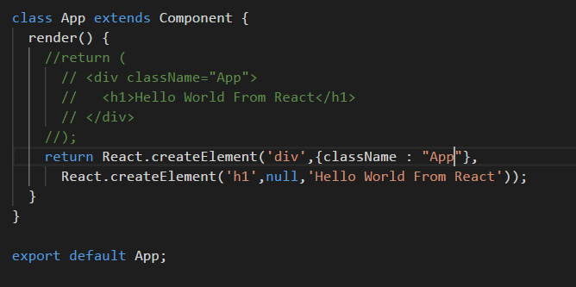
Understanding JSX

Slide 6
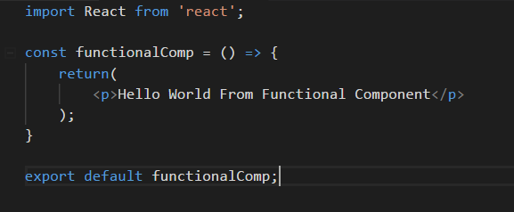
Functional Components

Slide 7
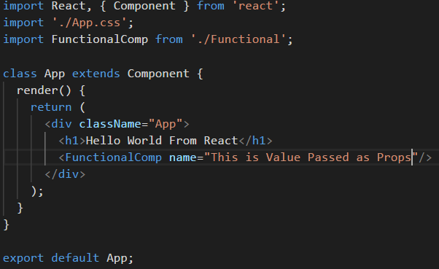
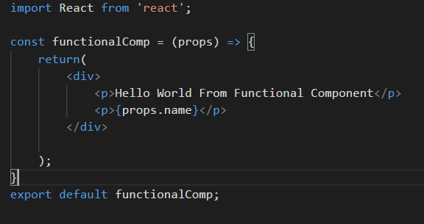
Working with Props

Slide 8
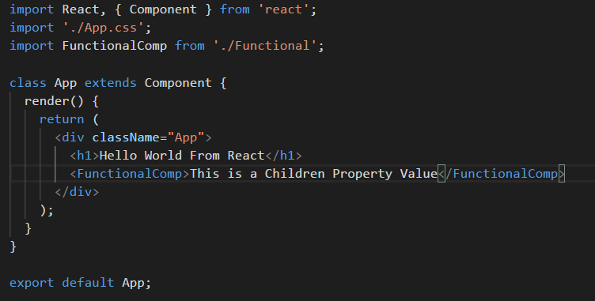
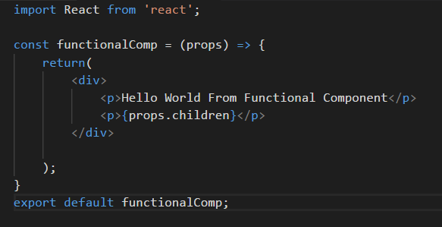
Understanding the Children Property

Slide 9
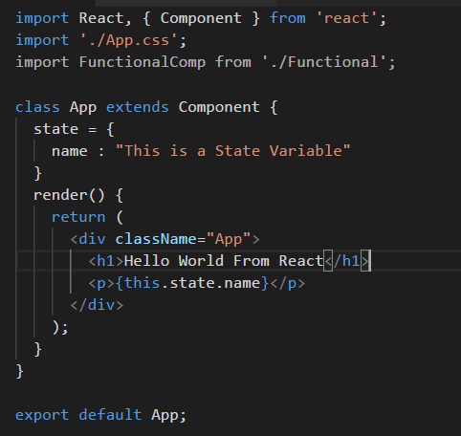
State

Slide 10
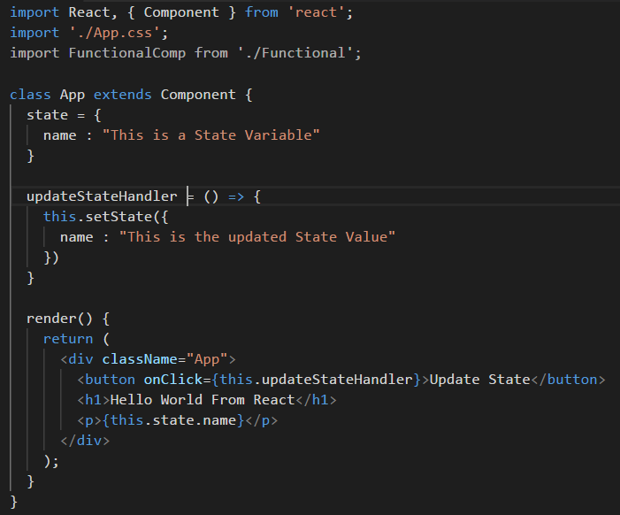
Manipulating the State

Slide 11
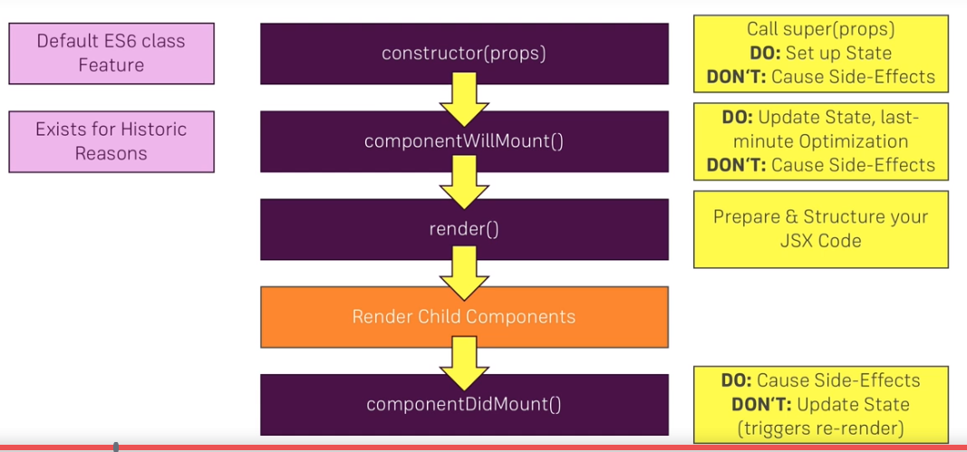
Component Lifecycle - Creation
Photo Source : Udemy

Slide 12
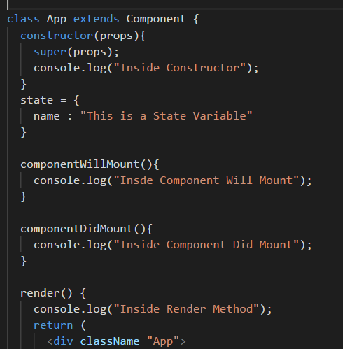
Component Lifecycle – Creation (Continued)

Slide 13
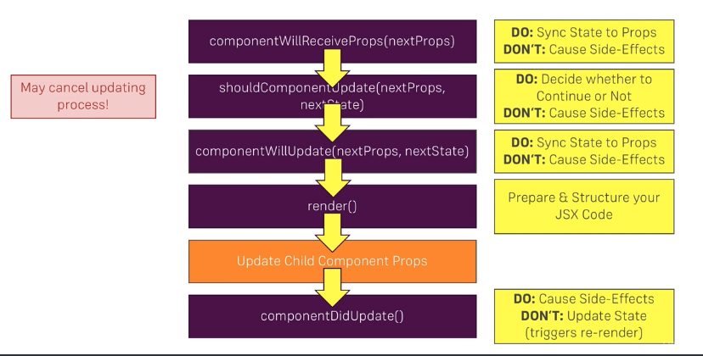
Component Lifecycle - Update
Photo Source : Udemy

Slide 14
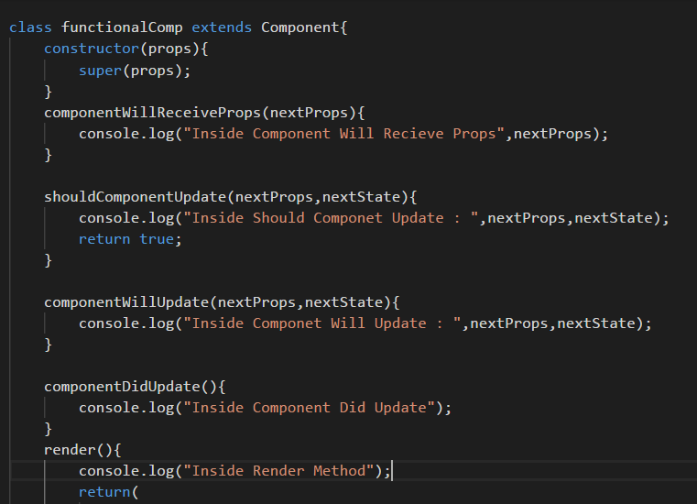
Component Lifecycle – Update (Continued)

Slide 15
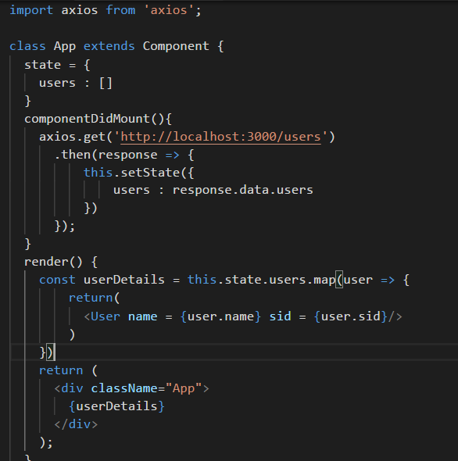
HTTP GET Request

Slide 16
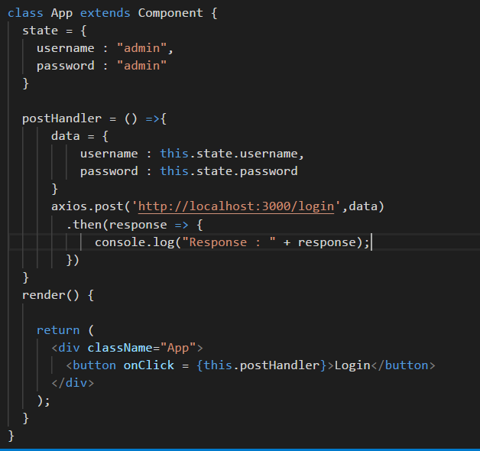
HTTP POST Request

Slide 17
DEMO

Slide 18
MOCHA DEMO

Slide 19
JMETER DEMO
http://jmeter.apache.org/download_jmeter.cgi

